Slide 1
PYTHON PROGRAMMING Lab2
Zhuoyue Zhou
MS. Candidate in GISDE
Email: zhzhou@clarku.edu

Slide 2
Lecture Review
Modulus Operator: %
Boolean Expressions: TRUE or FALSE
Comparison Operators: produce boolean values
Logical Operators: and, or, not

Slide 3

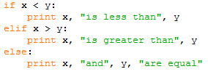
Lecture Review
Conditional Statements: Execute parts of your code only when some condition is met
if else Statement: two possibilities
Chained Conditionals: more than two possibilities

Slide 4
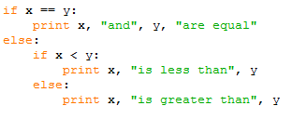
Lecture Review
Nested Conditionals: One conditional can also be nested within another.
Note: Although the indentation of the statements makes the structure apparent, nested conditionals become difficult to read very quickly. In general, it is a good idea to avoid them when you can.

Slide 5
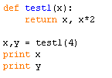

Lecture Review
Return Statement: could terminate the execution of a function, the remaining lines of the function are not executed.
Fruitful functions: Return values from a function
can have multiple return statements, one in each branch of a conditional, but only one will be executed:
can return multiple values in one return statements

Slide 6

Lecture Review
Keyboard input: built-in functions that get input from the keyboard
raw_input: returns what the user types as a string

Slide 7
Lab 2
1. Return three different values based on the comparison results
2. Return length of z, given the value of x
and y
3. Enter percentage scored, return the Grade
If less than 81, the return the message: “You did not do very well in this course!”
z
y
x

Slide 8
Lab 2
4. Define two functions. (x1,y1,x2,y2)
slop()
intercept()
5. Define a function to check the destination and weight for the package, and print different messages.
lower() upper()

Slide 9
Lab2 Submission
Due Next Friday(Feb. 5) 1:25pm.
One python script containing all the five functions.
Naming HW files: ZZhou_Lab2.py

